Slide 1
A Simulator for intelligently scheduling data parallel workloads BTP presentation
Joru Saikumar-17ME33037
Advisor : Prof. Soumyajit Dey
mentored by Anirban Ghose

Slide 2
Parallel Computing
Computation divided into subcodes and run across multiple devices parallely.
Two ways of achieving Parallelism:-
Data level Parallelism-Same function, data divided across devices.
Task level Parallelism-Entire data used in multiple functions.

Slide 3
Heterogeneous Programming
More than one kind of processor cores
Widely used in High Performance Computing(HPC)
Applications involving Deep learning, Linear Algebra, Computational fluid mechanics and simulations in physics.
Writing applications-OpenCL and CUDA frameworks

Slide 4
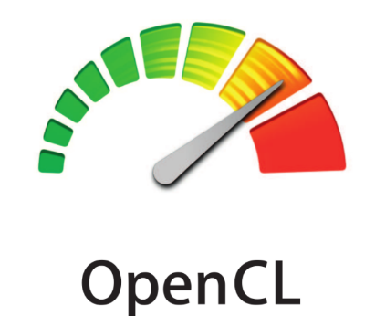
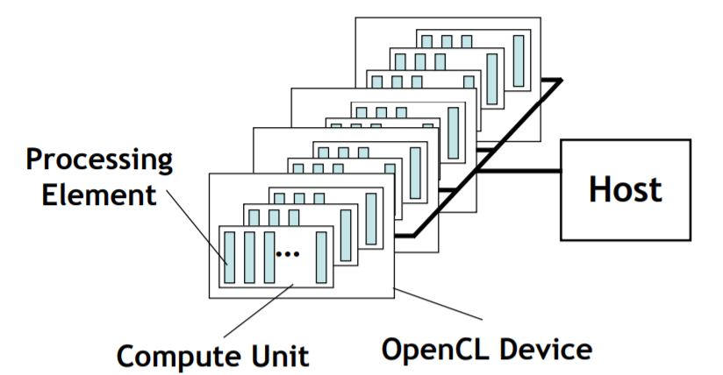
OpenCL
Portability to run same program on different types of devices
Kernel-functions executed on OpenCL device
OpenCL device Compute units(work-groups) Processing elements(work-items)
(Compute device)

Slide 5
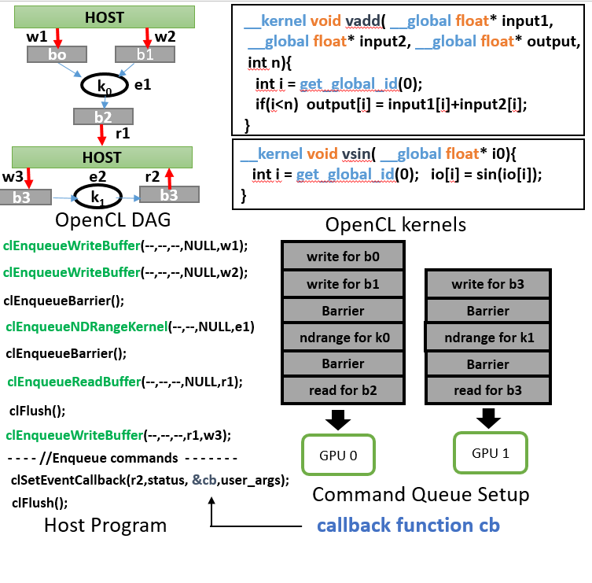
OpenCL Execution model
An OpenCL application DAG comprises of kernels with dependencies between input and output buffers.
Kernels-run on accelerator devices, Host program-runs on single core CPU device.
Host program – responsible for scheduling the kernels following the dependency constraints

Slide 6


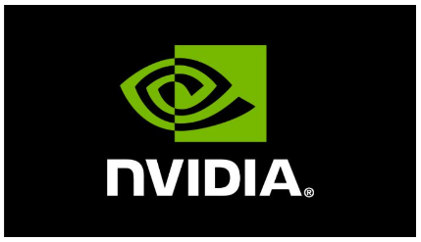
Designer Overhead
Steep learning curve for heterogeneous programming
Complex host side development
User must be familiar with scheduling methodologies for optimum application to architecture mapping(for minimum makespan).

Slide 7
Proposed solution
Front end/GUI
Mapping kernels to devices
Simulator
CPU
CPU
GPU
CPU
DAG
GPU
GPU
Mapped DAG
Target devices

Slide 8
Contributions
A GUI enabled frontend providing a higher level abstraction thus enabling users to specify application dependencies with ease.
Machine learning based implementations for ascertaining task device mapping decisions(topology oblivious and topology aware)

Slide 9
Graphical User Interface
Allows users to create their own application DAGs without writing any complex codes and input formats.
Built using Tkinter in python
Select list of readily available database kernels from drop down menu

Slide 10
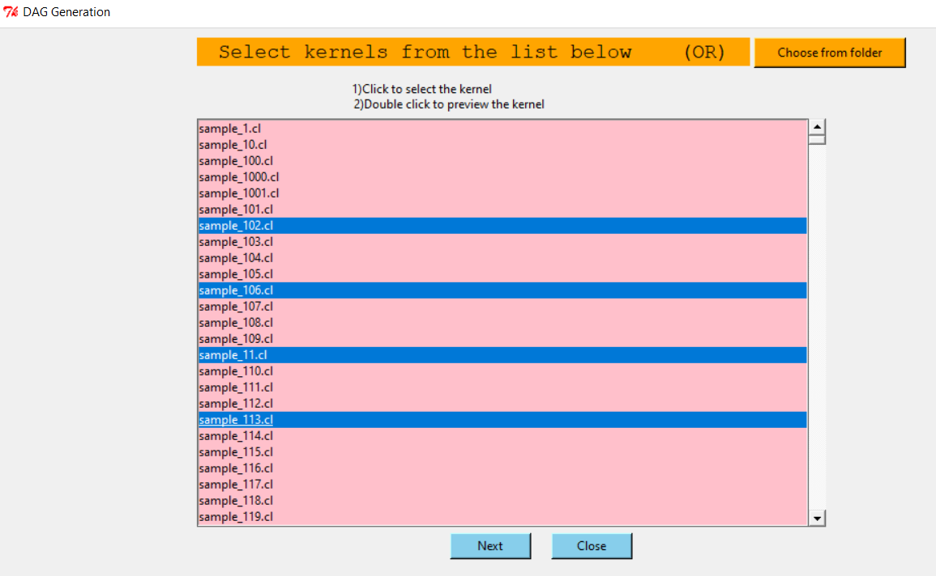

Slide 11
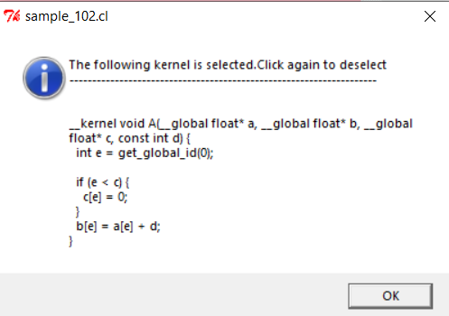
Double click on the kernel’s entry for preview.
Use Choose from folder button to select kernels from a custom folder.
The nodes for kernels and buffers are automatically added in the canvas

Slide 12
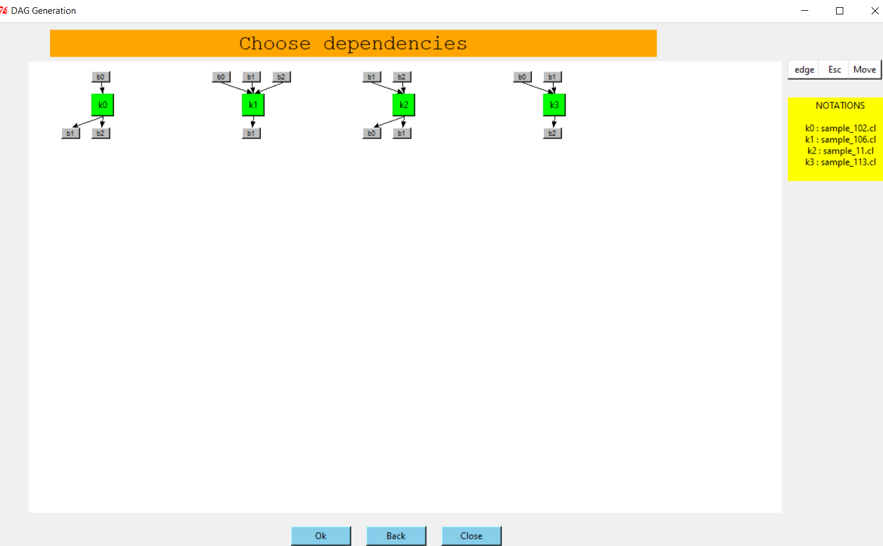

Slide 13
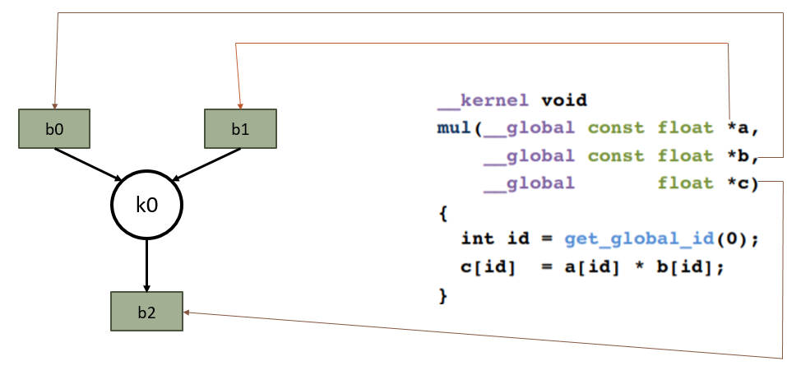
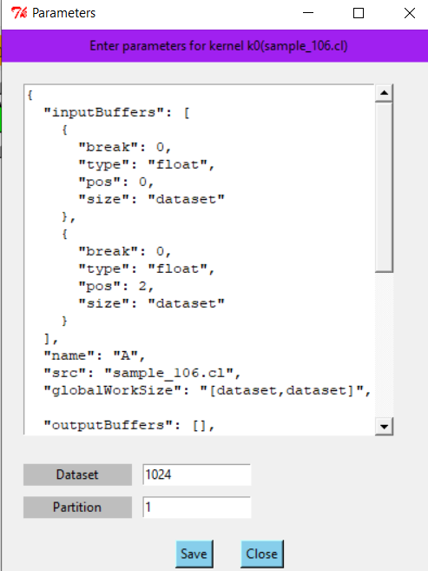
Buffer nodes are added by parsing through the kernel.
Parameters for each kernel – edit Json text in Parameters window
Symbolic variables – entry widgets at the bottom.
Notes:
The GUI parses through the function signature of the kernel and adds the corresponding buffers and buffer to kernel dependencies.
So if he chooses a kernel for vector multiplication where there are two inputs and one output the nodes and edges are added as shown.

Slide 14
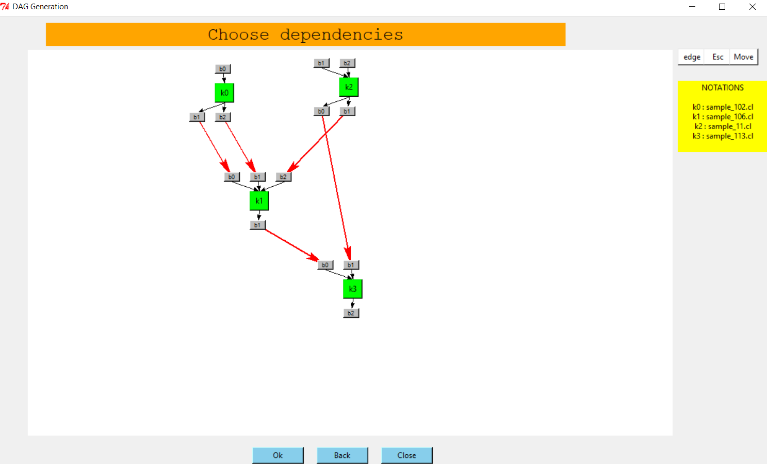
Specify the dependencies by drawing in the canvas.

Slide 15
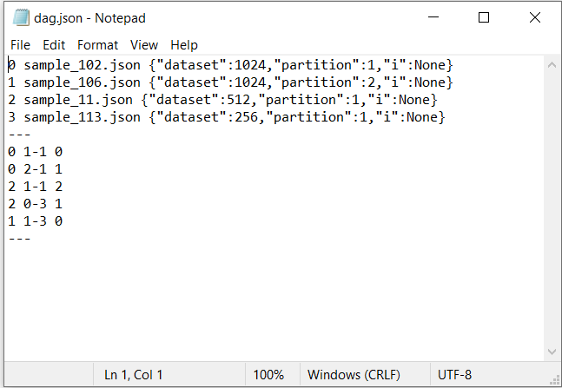
JSON Specification file created when submitting the DAG.
Used by the backend of the simulator for creating DAGs using Networkx.

Slide 16
Kernel mapping stage
The DAG generated through GUI-Each node mapped to run on GPU or CPU device.
Basically, generate a command queue for each device
Two types of mapping:
A)Topology oblivious mapping
B)Topology aware mapping

Slide 17
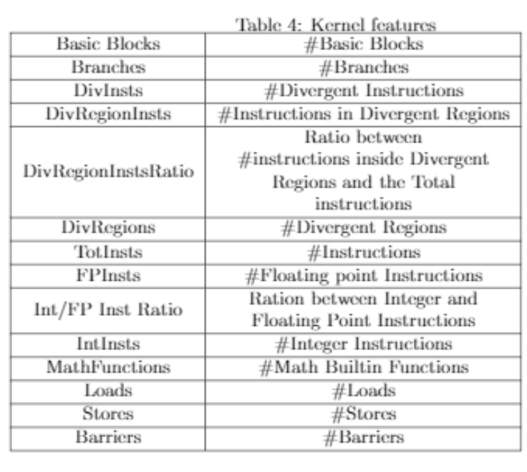
A)Topology oblivious mapping
Kernels mapped to devices individually
Feature pass
Machine learning Algorithm
New kernel
Dataset of kernels
Data preparation
Training a model
Trained
model
Run times
Prediction of kernel boundness
Notes:
In this the kernels are mapped to devices individually.
We had a dataset of kernels and we did a feature pass to generate a feature vector for each kernel. Feature pass refers to the traversal of a compiler through the entire program and check for number of blocks, branches, and number of floating point operations and integer operations and many. We ran the kernel on each type of device and get the timing files. Combining both we prepare data containing feature vector corresponding to its bound-ness to device for training.

Slide 18
Trained logistic regression and XGBoost classification models.
Imbalanced dataset – used SMOTE sampling technique.
Feature selection methods for choosing only best features for the model.
RandomizedSearch – for tuning hyper-parameters.
Evaluation metrics used: 20% split test data, 10-fold cross-validation
Notes:
Total 2685 observations-504(20%) belong to CPU and 2181(80%) belong to GPU. [labels 0 for CPU,1 for GPU]

Slide 19
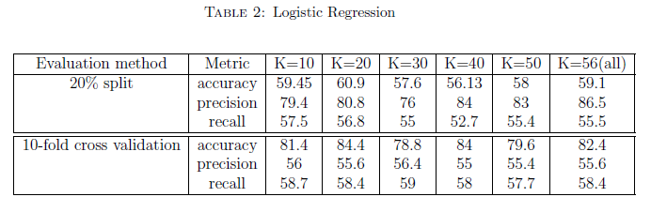
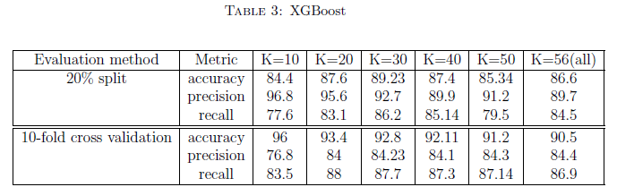
XGBoost over-performed logistic regression model with 10-fold cross validation accuracy of 93.4%. For logistic regression it is 84.4%.
Notes:
The tables show the results of the models. The accuracy, precision and recall for 20% split and 10-fold cross validation and for different number of selected features.
Precision-number of actual positives out of predicted positives, Recall – Number of actual positives predicted correctly out all the actual positives.
For both the models selecting we obtained good results for selecting 20 features than selecting any other number of features.

Slide 20
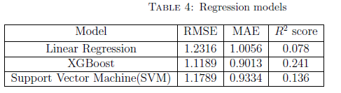
Also trained linear regression, XGBoost regression, SVM for predicting the speedup ratios.
Evaluated using RMSE, MAE and R² score.
Notes:
Speedup ratio = cpu time/gpu time.
R² (coefficient of determination)score = 1-MSE(model)/MSE(constant model)

Slide 21
B)Topology aware scheduling
Host
Kernel mapping depends on state information of neighborhood kernels as well.
Collection of kernels mapped to the same device affect synchronization and data transfer overheads.
b0
b1
b0
b1
k0
CPU
k1
CPU
b2
b2
Host
b0
b1
k2
GPU
b2
Host
Notes:
Synchronization and data transfer overheads That means in this example if both k0 and k1 are mapped to same CPU device and k2 is mapped to GPU device. k2 should start only after both k0 and k1 completes but both of them should be run on same devices. That means the GPU device remains idle until the CPU device executes both of them. But ideally k1 should be running simultaneously on GPU device. Hence the kernel mapping should be done on the DAG as a whole. A graph is a non Euclidean data structure and the standard CNNs and DNNs work only on Euclidean data structures. So in order to apply on the DAG we are planning to use graph neural networks.

Slide 22
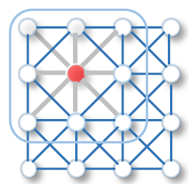
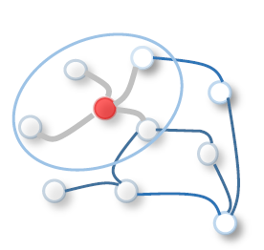
Graph neural networks-capture the dependence of graphs via message passing between nodes.
CNNs involves convolution and pooling operations using a 2D or 3D filter of weights.
GCNNs carry out message passing using filter of essential nodes and edges.
Euclidean space
non Euclidean space
Notes:
CNNs and GCNNs work almost in a similar way. In CNN we generate a new node representation for each pixel by applying convolution and pooling operations over a filter of weights around the pixel. GCNNs also use a similar filter but here the filter is of irregular shape and have varying number of nodes. In both cases we use filter of arbitrary depth.
In GCNNs we call this operation message passing between nodes.

Slide 23
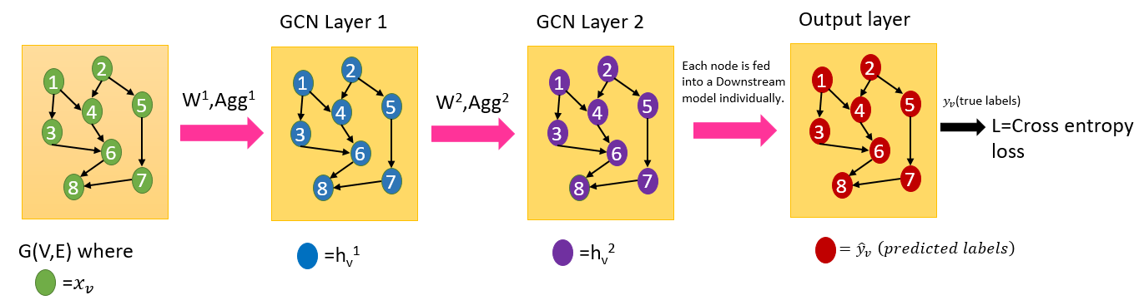
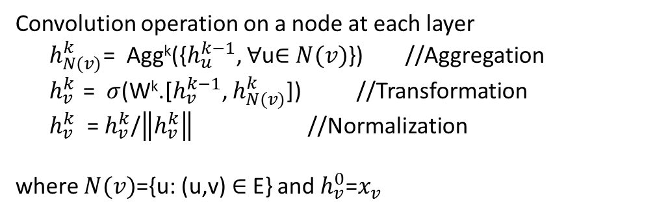
GraphSAGE – A variant of GCNNs
Convolution operation on a node at each layer
$h_{N(v)}^{k}$= Agg^{k}({$h_{u}^{k−1}$, $∀$u$∈$ $N(v)$}) //Aggregation
$h_{v}^{k}$ = $σ$(W^{k}.[$h_{v}^{k−1}$, $h_{N(v)}^{k}$]) //Transformation
$h_{v}^{k}$ = $h_{v}^{k}$/$\left\|h_{v}^{k}\right\|$ //Normalization
where $N(v)$={u: (u,v) $∈$ E} and $h_{v}^{0}$=$x_{v}$

Slide 24
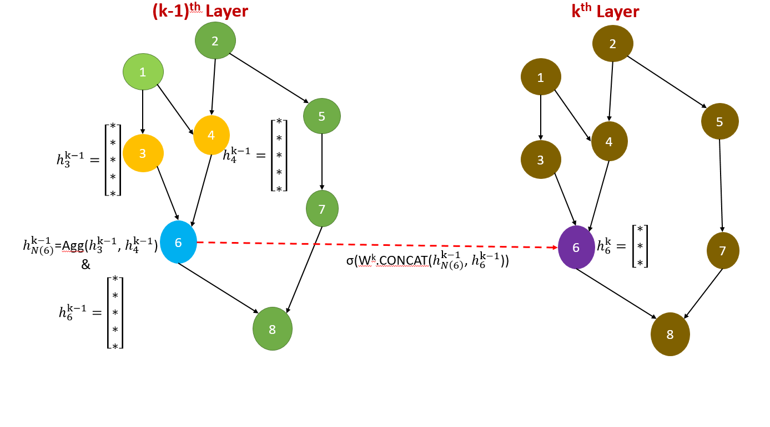

Slide 25
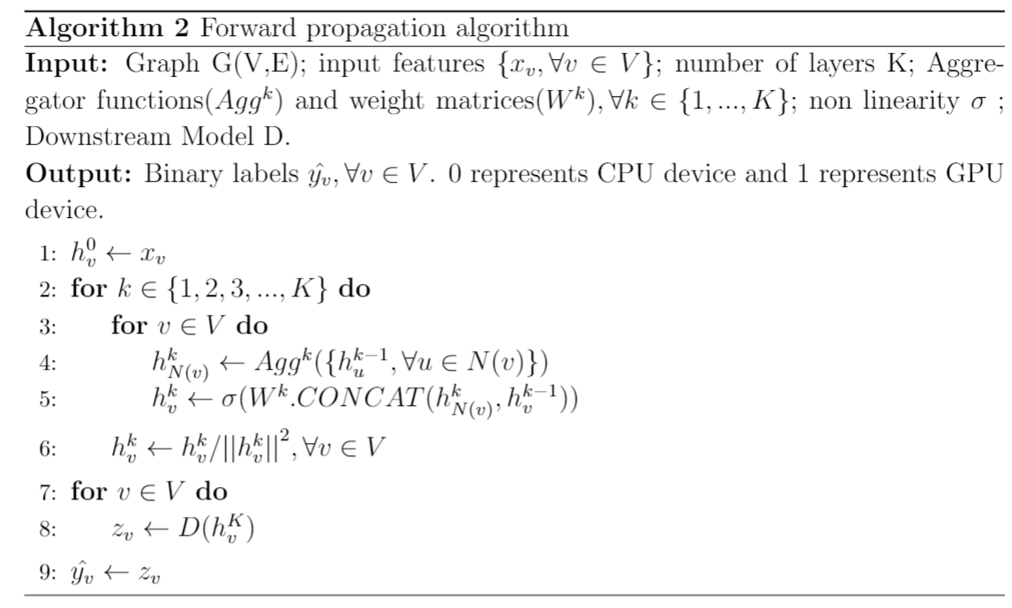
W^{k} => Weight matrices for transformation.
Agg^{k} => Aggregator function:
1)Mean aggregator-Element wise mean of the neighborhood node vectors(No trainable parameters)
2)LSTM aggregator-Based on LSTM architecture –has trainable parameters but permutation dependent
3)Pooling aggregator-element wise max pooling after transforming each neighbor vector with a fully connected layer(trainable parameters)

Slide 26
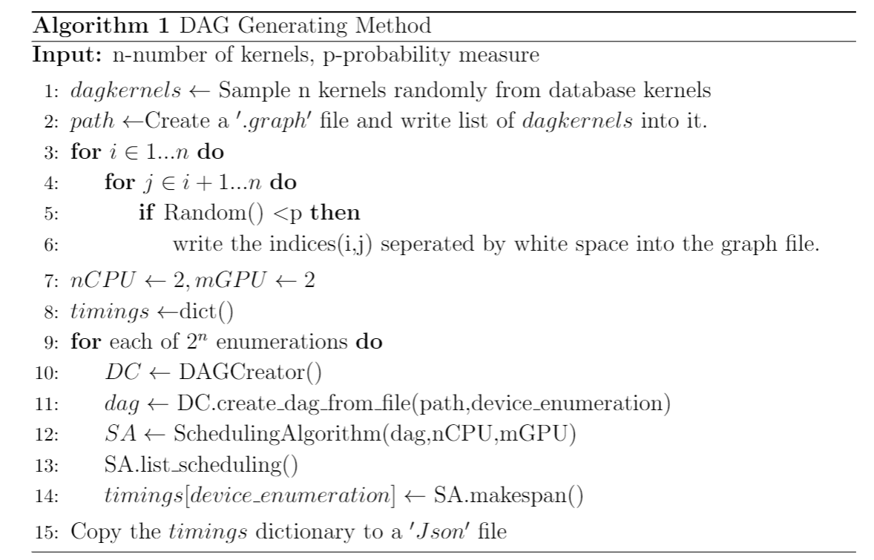
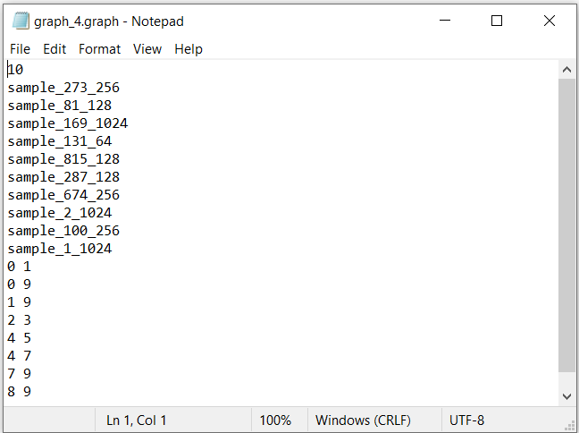
Training data – Random DAG Generator

Slide 27
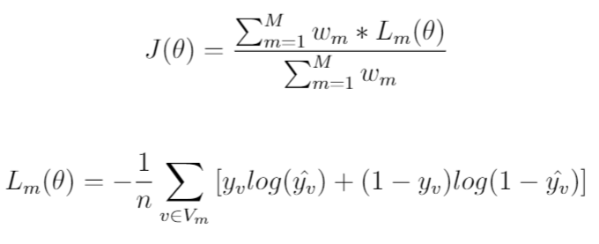
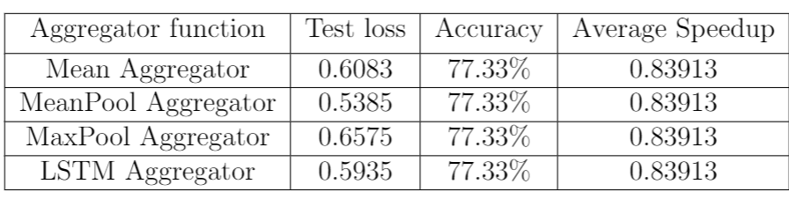
Loss function:
Trained model with 3 GCN layers – dimension of state vectors at each layer = 16, downstream model = Logistic Regression.
Highly unbalanced model –
Predicting single class always.

Slide 28
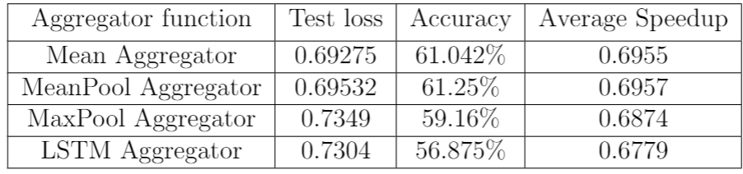

Introduced new parameter b [0,1] in DAG Generator – obtained a balanced dataset.
$$∈$$

Slide 29
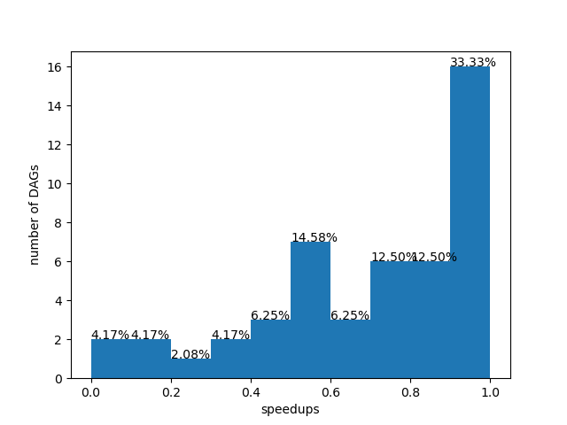
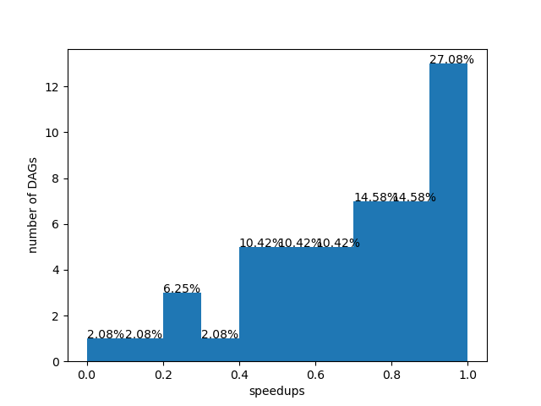
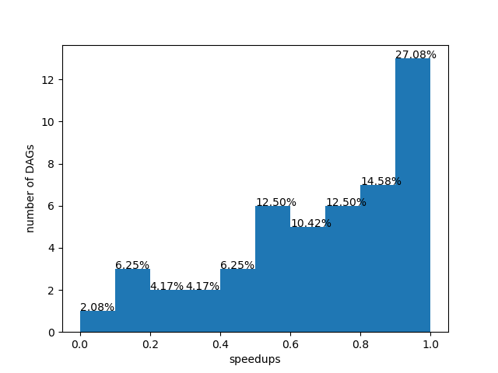
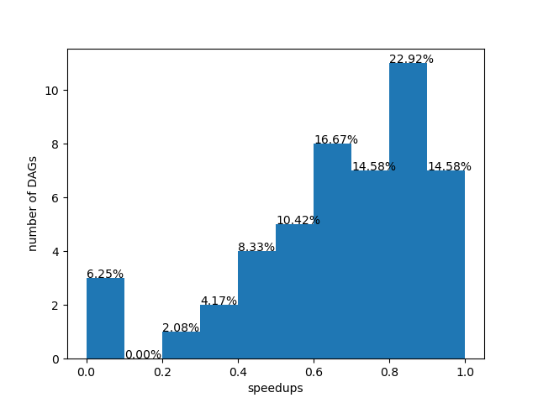
a)Mean aggregator
b)Mean Pool aggregator
a)Max Pool aggregator
a)LSTM aggregator

Slide 30
Thank you

